Slide 1

PERSONAL LEADERSHIP PORTFOLIO
Student’s Name
Institution of Affiliation
Date

Slide 2

Introduction
Leadership can be described as the ability to inspire courage in other people. A leader has to cultivate courage within him or herself before inspiring or provoking courage in other people. A personal leadership portfolio reflects activities, accomplishments, experiences, programs and skills that have contributed to ones personal leadership development. This leadership portfolio demonstrates my leadership skills through individual accomplishments and related personal experiences. In this portfolio, I will illustrate my personal values, vision, mission, goals, leadership philosophy, and leadership skills I acquired through my personal experiences.
Notes:
A personal leadership portfolio is a reflection of individual accomplishments, personal experiences, programs and skills that have contributes to my personal leadership development. This leadership portfolio demonstrates my leadership skills through individual accomplishments and related personal experiences. In this portfolio, I will illustrate my personal values, vision, mission, goals, leadership philosophy, and leadership skills I acquired through my personal experiences

Slide 3


Vision
A personal vision statement states what I want to achieve personally and professionally in future. It helps keep myself on track. A personal vision statement acts as a guide in important life decision making, planning how to achieve goals and realizing the dreams.
My personal leadership vision is to: consistently lead with fairness, humility and integrity. To mentor other people through honest communication and creating an enjoyable, and respectable professional working environment.
Notes:
A personal vision statement states what I want to achieve personally and professionally in future. My vision is to consistently lead with fairness, humility and integrity. To mentor other people through honest communication and creating an enjoyable, and respectable professional working environment

Slide 4

Mission
A mission statement defines personal values. A mission helps guide decisions to help meet goals. My mission statement is:
To be a forward thinking leader making a difference and living a balanced life.
Notes:
A personal mission is a statement that that describes personal values, who I am and my perspectives of success. A mission guides my decisions and help me focus to achieve my long-term goals. A mission statement establishes boundaries that help to make decision-making easier. A mission statement is essential because it can guide personal decision-making. My personal mission is to be a forward thinking leader making a difference and living a balanced life

Slide 5

Values
Values refers to important things in the way people live and work. Values determine a person’s priorities. Personal values are unique for every individual and even differs among people of the same profession. My personal values are;
Accountability
Authenticity
Courage
Fairness
Honesty
Integrity
Professionalism
Notes:
Values are important things that people learn to live and work with. Values influence people’s priorities. Personal values that guide my leadership style include accountability, honesty, authenticity, courage, fairness, integrity and professionalism.

Slide 6

Goals
Goals are things that I wants to accomplish. Goal setting is essential because it helps me accomplish better results, be motivated and take responsibility for what I do. Personal and professional leadership goals are important as they help me determine my priorities.
Make smarter decisions
Build stronger connections
Better time management
Learn to solve conflicts effectively
Notes:
All our lives are directed towards achieving some life goals, whether we are thinking about them carefully or not. To be more proactive and productive, all of us have to learn how to set specific personal goals that we can use to measure our personal growth and progress. My personal leadership goals is to make smarter decisions, build stronger connections, learn to solve conflict effectively and better time management.

Slide 7

Leadership Skills
Individual accomplishments and personal experiences have had in my life has enabled me to gain important leadership skills which I intend to continuously build on to create and improve my leadership style. Leadership skills that I have include;
Personal skills: managing personal stress, self-awareness, finding solutions to challenges and problems.
Interpersonal skills: conflict management, motivating others, coaching and counselling.
Technical skills: Budgeting, project management, personnel management, and making policies.
Group skills: Teamwork, delegation, and managing change.
Notes:
My personal experiences have enabled be acquired important leadership skills that will help in creating and improving my leadership style. I have acquired important leadership skills including the skills to solve problems, manage personal stress, solve conflicts, budgeting, motivate others, coaching and counselling, team work, managing change and delegation.

Slide 8

Leadership Philosophy
A leadership philosophy is described as a structured approach to leadership. It involves beliefs, sentiments and principles that guide me in leading others. A strong leadership philosophy is essential to my personal and professional success. When leadership philosophy are based on strong principles and values, leaders remain committed to their goals and are able to inspire and motivate other people to work toward achieving their goals (Speranza & Pierce, 2019). My leadership philosophy is important for various reasons including;
Provides consistency
Defines my character
Promotes collaboration
Notes:
A personal leadership philosophy refers to beliefs, sentiments and principles. My personal leadership philosophy is influenced by my beliefs and character. Good and effective leaders often tend to have clearly-defined personal leadership philosophies. Having personal philosophies promotes success and inspires a more productive working environment for everyone. When leadership philosophy are based on strong principles and values, leaders remain committed to their goals and are able to inspire and motivate other people to work toward achieving their goals.

Slide 9
Leadership Philosophy
Provides consistency: My personal leadership philosophy allows me to be consistent with my actions and behaviors.
Defines my character: A leadership philosophy helps define and understand my character. This is essential because character influences interaction with other people and how I handle different situations.
Promotes collaboration: personal leadership philosophy helps to promote meaningful collaboration. Once other people understand why I act or behave the way I do, they will be more suitable to collaborate with me as they understand my leadership style.
My leadership philosophy entail earning credibility by putting my efforts and attention towards success.
Notes:
My personal leadership philosophy is important for various reasons. It helps define my character: Having a personal leadership philosophy helps me to understand my character. It is crucial to understand by characters because character affects my interactions with other people and various situations. It provides consistency: a personal leadership philosophy makes me to be more consistent with my actions and behaviors. It also promotes collaboration with other people. Once other people understand why I act the way I do, they are more likely to collaborate with me as they are aware of my leadership style.

Slide 10
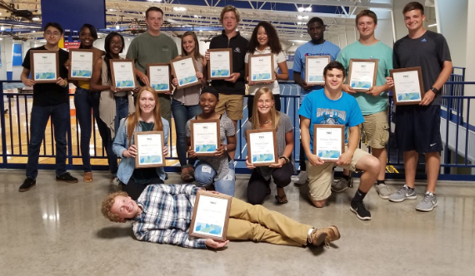
High School
Leadership is a strong and powerful skill to gain in high school. It helps one prepare for the future and success in various areas of your life. My high school had after school clubs that offered numerous leadership opportunities for students to enhance their leadership. At my high school, clubs had governing bodies that offered us with opportunities to become leaders. I was a part of the governing body of various clubs I was a member of during my high school which presented me with a unique opportunity to learn how to be an effective leader.
Notes:
Leadership is a powerful skill to obtain throughout high school that helps prepare students for the future as well as helps them succeed in different areas of their life. It’s important for high schools to provide leadership opportunities for their students to develop leadership skills. First, areas of leadership opportunities can be found in high school is within clubs such as athletics, theatre, and high school bands. Whatever the interest may be, there is a leadership opportunity out there somewhere and taking advantage of it before college is the key to success

Slide 11
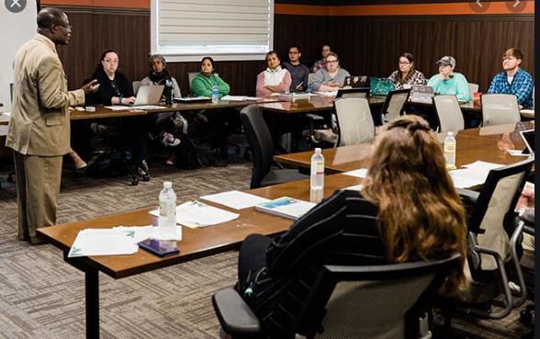

College
College provides students with opportunities to cultivate ambitions, beliefs, opinions, personal independence, and how they view the world. Some students however struggle to feel sense of purpose, belonging and direction in their lives. My college created an inclusive culture that encouraged students to develop critical skills and find voices through various leadership courses that would help us navigate through college and life in general. My college helped me learn to define various identities, build strong relationship and achieve tasks effectively.
Notes:
eadership is about the art of motivating, influencing and directing people so that they work together to achieve the goals of a team or broader organization. It’s important for students to experience leadership opportunities during their schooling, to learn the art of building relationships within teams, defining identities and achieving tasks effectively. It also provides an opportunity to learn to identify and display effective communication and interpersonal skills.

Slide 12


Leadership Motivation
This is a goal-driven characteristic that helps me accomplish my objectives. Motivation helps me to work towards achieving my goals. I am motivated by various intrinsic and extrinsic reasons including;
Personal growth
I am motivated by my personal capabilities, the potential of what I could achieve, and the realization of my aspirations and dreams. Additionally, I have been exposed to various forms of leadership through my personal and professional experiences thus, I understand how leadership develops an individual.
Helping others develop
Helping other people achieve their goals creates a sense of meaning and motivation for me. Rather than focusing on what makes my life worthwhile, I find motivation in the human connection and holding others up and helping achieve their dreams and aspirations (Rahardja, Moein & Lutfiani, 2018).
Notes:
I am motivated by various intrinsic and extrinsic factors to be a leader. I am inspired by my personal growth, the ability to help others achieve the best, the ability to make a difference, and social status. I have been exposed various forms of leadership in my personal experiences, and have learnt how proper leadership develops the individual. The ability to build upon my foundation motivates me and helps to cultivate and improve my leadership style.

Slide 13

Leadership Motivation
Making a difference
Leadership gives me a platform to influence many things in society. I am motivated by my abilities and the opportunity that leadership will grant me to make positive differences to achieve a better society.
Social status and Public recognition
Leadership accords people social status and people tend to follow them. I am motivated by the public recognition that is accorded to effective and successful leaders.
Notes:
Not everyone wants to be a leader, however in someway, everyone is influenced or inspired by some leader. I am motivated by the ability to help and guide other people to achieve their goals and aspirations. I always like the mantra, everyone has something to offer to the other. While helping others achieve their goals, I also learn from them. I want leadership that inspires others, and make impactful and lasting positive change.

Slide 14

Leadership Motivation
Motivated by results
Good and effective leaders are result oriented and are often attracted to leadership because they believe that somethings have to be done but they are being doing unless they do themselves. I am motivated by what I can be able to achieve as a leadership.
Motivated by relationships
I find is satisfying that other people seek my opinion and value my advice. I feel motivated to inspire others to do and achieve their best .
Notes:
Good leaders are often results oriented. They are attracted positions of power or leadership when they believe that something needs to be done and don't see it happening with the current leaders, therefore they opt for leadership to make it happen. When people are committed to specific goals or mission, they may find themselves motivated to lead even if they had never considered themselves as leaders. I find is satisfying that people seek my advice and value my opinion which drives me to motivate others. I have had experiences inspiring and motivating others to achieve the best and felt rewarded when they succeeded, it makes me to feel like a leader.

Slide 15

Conflict Management
Conflict management essentially involves the process of resolving conflict. During this process, negative outcomes of conflict are tackled while positive outcomes are enhanced (Elgoibar, Euwema & Munduate, 2017). Conflict management is an important leadership skill and used various tactics including:
Communication
Emotional intelligence
Creative problem solving
Impartiality
Positivity
Notes:
Conflict management entails the process of resolving conflicts. In the conflict management process, negative outcomes of conflicts are minimized while positive results are promoted and prioritized. Conflict management is an important leadership and management skill that leaders need to posses to address conflicts. In solving conflicts I use different tactics including creative thinking, negotiation, impartiality and positivity depending on the situation. Proper management of conflicts enables leaders to minimize interpersonal issues, enhance satisfaction, and produce better outcomes.

Slide 16
References
Speranza, C. R., & Pierce, A. (2019). Development of a Personal Leadership Philosophy: An Experiential and Reflective Opportunity in the Graduate Classroom. Journal of Leadership Education, 18(3).
Rahardja, U., Moein, A., & Lutfiani, N. (2018). Leadership, competency, working motivation and performance of high private education lecturer with institution accreditation B: Area kopertis IV Banten province. Man India, 97(24), 179-192.
Elgoibar, P., Euwema, M., & Munduate, L. (2017). Conflict management. In Oxford research encyclopedia of psychology.

